Slide 1
SRA-001 | Module 2
HISTORY OF CUPPING AROUND THE WORLD
From Ancient Civilisations to Contemporary Revival
SUNNAH REMEDIES · INSTITUTE OF PROPHETIC MEDICINE

Slide 2
Module Overview
01
Ancient Civilisations
Egypt, China, Greece — tracing the earliest evidence of cupping therapy across three great civilisations.
02
The Islamic Golden Age to Today
Scholarly contributions, colonial decline, and the contemporary revival of professional Hijama.
SRA-001 | Certified Hijama Practitioner

Slide 3
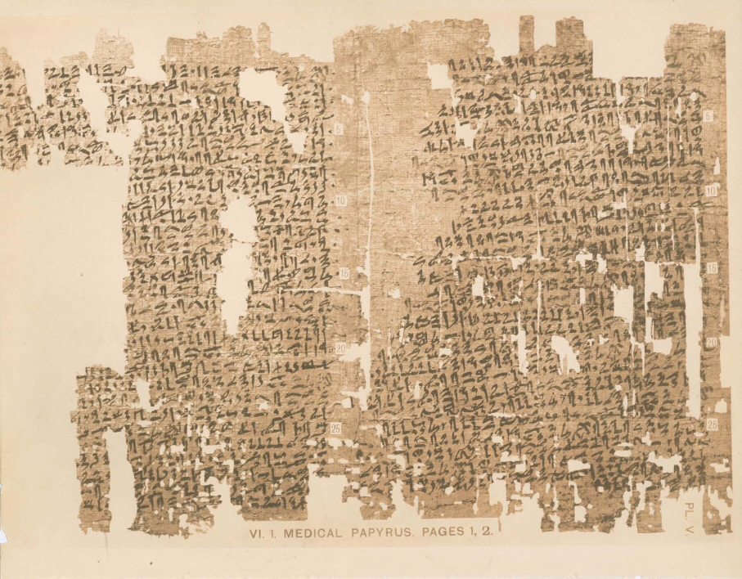
01
CHAPTER
Ancient Civilisations
Egypt, China, Greece — The Early Evolution of Cupping

Slide 4
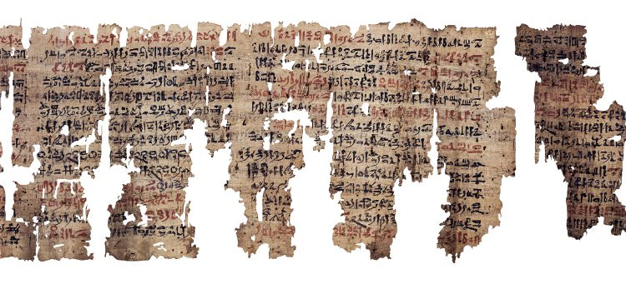
M2 | SRA-001
History of Cupping Around the World
SUNNAH REMEDIES
Ancient Egypt: The Earliest Documented Evidence
C. 1550 BCE
The Ebers Papyrus (c. 1550 BCE) contains the earliest written record of cupping therapy. This 110-page medical scroll describes the removal of disease-causing substances through suction.
Egyptian physicians believed in metu — channels through which bodily fluids flowed. Cupping was used to restore balance by drawing harmful substances to the surface.
KEY CONTRIBUTIONS
● Ebers Papyrus — 700+ remedies, cupping described
● Edwin Smith Papyrus — surgical procedures
● Kahun Papyrus — gynaecological treatments
● Concept of channels (metu) — precursor to meridians
● Cupping combined with incision and scarification
The Ebers Papyrus — one of the oldest medical texts known
SRA Scholarly Note: While the Ebers Papyrus is the earliest written record, archaeological evidence suggests cupping-like practices may predate it. Claims beyond c. 1550 BCE require careful source criticism.
04

Slide 5
M2 | SRA-001
History of Cupping Around the World
SUNNAH REMEDIES
Ancient China: The Development of Systematic Cupping
281 CE ONWARDS
Chinese Cupping: Key Facts
China developed the most systematic approach to cupping. The earliest documentation appears in Zhao Xuemin's writings (281 CE), describing the use of animal horns to create suction.
The practice — called "ba guan" (pulling up the jar) — became integrated with the broader framework of Traditional Chinese Medicine.
Earliest documentation: 281 CE by Zhao Xuemin
Original term: "Jiao fa" (horn method)
Evolved term: "Ba guan" (pulling the jar)
Primary technique: Fire cupping
Theoretical basis: Meridians, qi, blood stagnation
Key text: Comprehensive Medicine by Honourable Masters (Wang Weiyi, 1026)
Modern status: Integrated into TCM practice globally; NCCIH recognises it as a complementary therapy
SRA Clinical Pearl: While TCM cupping theory differs from Hijama's Islamic framework, both share the practical observation that suction on the skin produces therapeutic effects. Evidence from TCM research informs Hijama practice.
TCM THEORETICAL FRAMEWORK
Meridians
Qi (Chi)
Blood Stagnation
Energy pathways through which qi flows
Vital life force circulating through the body
Blocked flow causing pain and disease
INSTRUMENT EVOLUTION
Animal horns → Bamboo cups → Ceramic → Bronze → Glass → Modern plastic
Each material brought different thermal and suction properties.
05

Slide 6
M2 | SRA-001
History of Cupping Around the World
SUNNAH REMEDIES
Ancient Greece: Hippocratic Medicine and Cupping
5TH–4TH CENTURY BCE
Greek Cupping: Clinical Approach
The Hippocratic Corpus (5th–4th century BCE) contains detailed clinical descriptions of cupping. Hippocrates recommended cupping for menstrual irregularities, lung diseases, and musculoskeletal conditions.
Greek medicine understood cupping through the four humours — the theory that health depends on the balance of bodily fluids.
Greek physicians approached cupping with systematic rigour:
1. Diagnosis — Identify humoural imbalance
2. Indication — Determine if evacuation was appropriate
3. Contraindication — Recognise when cupping was harmful
4. Technique — Apply cups with precision
5. Follow-up — Monitor restoration of balance
This approach mirrors the modern clinical decision-making process.
"The physician must tell the antecedents, know the present, and foretell the future." — Hippocrates
THE FOUR HUMOURS
Blood
Hot and wet
Phlegm
Cold and wet
Black Bile
Cold and dry
Yellow Bile
Hot and dry
KEY GREEK FIGURES
Hippocrates (c. 460–370 BCE): Described cupping for lung diseases, menstrual disorders, and pain
Herodotus (c. 484–425 BCE): Documented cupping use among Egyptians and Scythians
Galen (129–216 CE): Expanded humoural theory; systematic approach to evacuation therapy
06

Slide 7
M2 | SRA-001
History of Cupping Around the World
SUNNAH REMEDIES
The SRA Historical Timeline: Ancient Period
c. 1550 BCE
c. 400 BCE
281 CE
7TH–13TH C.
Egypt
Greece
China
Islamic Age
Ebers Papyrus: earliest written record of cupping
Hippocratic Corpus: clinical descriptions of cupping therapy
Zhao Xuemin: systematic documentation of cupping in TCM
Golden Age: comprehensive scholarship on Hijama
COMPARATIVE OVERVIEW: ANCIENT CIVILISATIONS
Civilisation | Key Text | Theoretical Basis | Instruments | Key Contribution
Egypt | Ebers Papyrus (c. 1550 BCE) | Metu (channels) | Animal horns, bronze cups | Earliest written record
Greece | Hippocratic Corpus | Four humours | Bronze cups, glass cups | Systematic clinical approach
China | Zhao Xuemin (281 CE) | Meridians, qi, blood stagnation | Bamboo, ceramic, horn | Systematic TCM integration
Islamic | Zad al-Ma'ad (14th c.) | Prophetic tradition + observation | Glass, horn, metal | Comprehensive scholarship
07

Slide 8
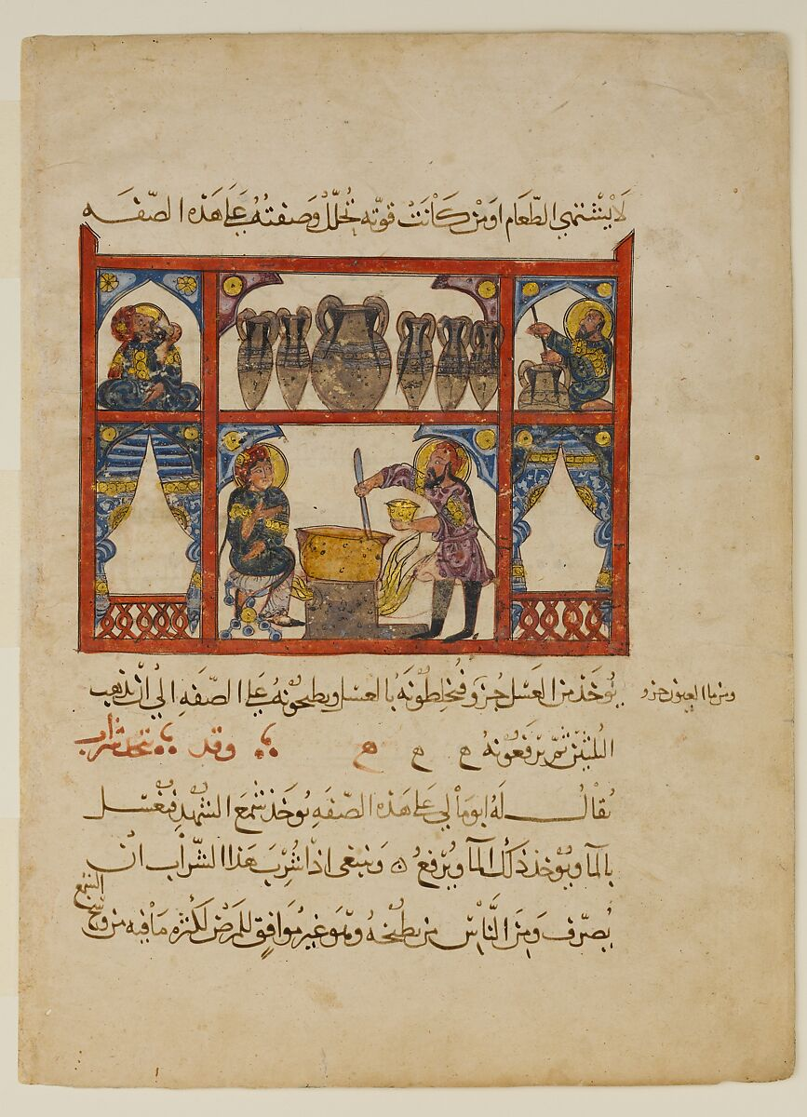
02
CHAPTER
The Islamic Golden Age to Today
Scholarly Contributions, Decline, and Contemporary Revival

Slide 9
M2 | SRA-001
History of Cupping Around the World
SUNNAH REMEDIES
The Islamic Golden Age: A Renaissance of Medicine
7TH–13TH CENTURY CE
The Islamic Golden Age (7th–13th century CE) represents the most significant period in cupping history. Under Islamic civilisation, cupping evolved from folk practice into a scholarly medical discipline.
Three factors drove this: the translation movement, the bimaristan (hospital) system, and Tibb al-Nabawi (Prophetic Medicine).
THREE TRANSFORMATIVE FACTORS
1
The Translation Movement
Scholars translated Greek, Persian, Sanskrit, and Egyptian medical texts into Arabic, preserving and synthesising knowledge.
2
The Bimaristan System
Institutional hospitals with wards, pharmacies, and teaching facilities — cupping practised under medical supervision.
3
Tibb al-Nabawi
Prophetic Medicine — the scholarly study of health practices from the Prophet Muhammad (peace be upon him).
Islamic Golden Age manuscript — De Materia Medica of Dioscorides
09

Slide 10
M2 | SRA-001
History of Cupping Around the World
SUNNAH REMEDIES
Key Islamic Scholars and Their Contributions
Ibn Sina (Avicenna) — 980–1037 CE
Al-Zahrawi (Albucasis) — 936–1013 CE
Al-Qanun fi al-Tibb (The Canon of Medicine) — the most influential medical text in history. Documented cupping indications, contraindications, and techniques with systematic precision. Used in European medical schools until the 17th century.
Al-Tasrif li-man 'ajaza 'an al-Ta'alif — 30-volume medical encyclopaedia. Invented surgical instruments including cupping tools. His illustrated surgical manual set the standard for operative technique for centuries.
Al-Razi (Rhazes) — 854–925 CE
Ibn al-Qayyim — 1292–1350 CE
Al-Hawi fi al-Tibb (The Comprehensive Book of Medicine). Distinguished smallpox from measles. Documented clinical cases with cupping, emphasising observation and evidence over theory alone.
Zad al-Ma'ad (Provisions of the Hereafter) — the most comprehensive work on Prophetic Medicine. His section on Hijama remains the definitive scholarly text, combining authentic Hadith with clinical observation.
SHARED SCHOLARLY APPROACH
These scholars shared a common methodology: (1) Collect and verify sources — whether Hadith or clinical observation, (2) Synthesise existing knowledge — Greek, Persian, Indian, and Egyptian traditions, (3) Add original observation — document new clinical findings, (4) Organise systematically — create reference works for future practitioners. This methodology — source verification, synthesis, original observation, systematic organisation — is the scholarly tradition SRA continues.
10

Slide 11
M2 | SRA-001
History of Cupping Around the World
SUNNAH REMEDIES
Ibn al-Qayyim and the Scholarship of Hijama
1292–1350 CE | DAMASCUS
Why Zad al-Ma'ad Matters Today
"Hijama is the most beneficial of all medical procedures — it removes harmful blood, relieves pain, and restores health."
Ibn al-Qayyim's work remains the foundational text for three reasons:
1. Source Verification
He authenticated Hadith using rigorous methodology — checking chains (isnad) and narrator reliability.
2. Clinical Observation
He verified claims through patient outcomes, adding his own clinical notes.
3. Systematic Organisation
He created a bedside reference — indications, contraindications, technique, all in one place.
"This is the scholarly tradition SRA continues."
— Ibn al-Qayyim, Zad al-Ma'ad
Ibn al-Qayyim al-Jawziyya was a Hanbali scholar and physician whose Zad al-Ma'ad (Provisions of the Hereafter) is the most comprehensive work on Prophetic Medicine.
His methodology combined authentic Hadith with clinical observation, verifying traditional claims against patient outcomes.
IBN AL-QAYYIM'S CONTRIBUTIONS
● Documented Sunnah points with anatomical precision
● Established optimal timing (17th, 19th, 21st of lunar month)
● Described contraindications with clinical reasoning
● Created a systematic framework still used today
● Distinguished authentic from weak narrations
11

Slide 12
M2 | SRA-001
History of Cupping Around the World
SUNNAH REMEDIES
Decline, Colonialism, and Modern Revival
THE DECLINE
From the 18th century, traditional medicine faced decline:
● Colonial suppression of indigenous medical systems
● Institutional closure of bimaristans and madrasas
● Loss of manuscripts and scholarly lineages
● Shift to Western medicine as sole legitimate system
Global Spread of Hijama
Middle East
Strongest tradition — Saudi Arabia, UAE, Egypt, Turkey. Government-regulated.
South Asia
Pakistan, India, Bangladesh — deep Unani Tibb integration.
THE REVIVAL
Since the late 20th century, Hijama has revived:
● Islamic revival movements renewed interest in Sunnah
● Research growth — 177 RCTs by 2022
● Global spread — Middle East, Asia, Europe, Americas
● Professionalisation — SRA and similar institutions
Europe
UK, Germany, Netherlands — growing Muslim communities.
Americas & Africa
USA, Canada, Nigeria, South Africa — emerging markets.
The World Health Organisation recognises traditional medicine as an important component of healthcare systems globally.
12

Slide 13
M2 | SRA-001
History of Cupping Around the World
SUNNAH REMEDIES
The Contemporary Landscape: Evidence and Professionalism
FROM FOLK PRACTICE TO PROFESSIONAL THERAPY
Contemporary Hijama stands at a crossroads. The 21st century has seen an unprecedented shift from traditional folk practice to evidence-informed professional therapy. This transformation demands rigorous standards, systematic research, and intellectual honesty about both strengths and limitations.
KEY RESEARCH MILESTONES
2012
2022
2024
2026
Cramer et al. systematic review: 135 RCTs on cupping for pain conditions
Updated review: 177 RCTs. Evidence for back pain, neck pain, and hypertension confirmed
Mechanism research advances: NO release, myofascial decompression, immune modulation
SRA establishes the first international competency framework for Hijama practitioners
CURRENT CHALLENGES
Standardisation: No universal training standards exist outside SRA | Research quality: Many studies are small, single-blind, or methodologically weak | Regulation: Most jurisdictions lack specific Hijama legislation | Integration: Conventional medicine often views Hijama with scepticism | SRA's role: Addressing all four through the Academy Framework
13

Slide 14
M2 | SRA-001
History of Cupping Around the World
SUNNAH REMEDIES
Module 2: Summary and Key Takeaways
1
3,500+ Years of Practice
2
Islamic Scholars Led the Way
Cupping has been practised across Egypt, Greece, China, and the Islamic world for millennia.
Ibn Sina, Al-Zahrawi, Al-Razi, and Ibn al-Qayyim made the most comprehensive contributions.
3
Zad al-Ma'ad: The Foundational Text
4
Colonial Disruption, Then Revival
Ibn al-Qayyim's work remains the definitive scholarly reference for Hijama practitioners.
Colonialism caused significant loss of knowledge; the late 20th century saw remarkable revival.
5
Evidence-Informed Professionalism
The future demands rigorous standards, honest evidence, and professional accountability.
COMING NEXT — MODULE 3
KNOWLEDGE CHECK
Hijama in Islam
Question: Why is Ibn al-Qayyim's Zad al-Ma'ad considered the foundational text for Hijama?
Discuss in your Reflect–Learn–Apply journal.
Qur'anic foundations, authentic Hadith, Sunnah points, scholarly tradition, and the Evidence & Sunnah Matrix.
14

Slide 15
"And He will teach him the Book and wisdom and the Torah and the Gospel."
— Qur'an 3:48
Reflection: How does understanding the history of cupping deepen your respect for this therapeutic tradition?
MODULE 2 COMPLETE
SUNNAH REMEDIES · INSTITUTE OF PROPHETIC MEDICINE

